Slide 1
Hybrid AF™ Convergent Therapy Procedure for the Treatment of Long-Standing Persistent Atrial Fibrillation
Set-Up Guide
PE-US-0004C-0322-G

Slide 2
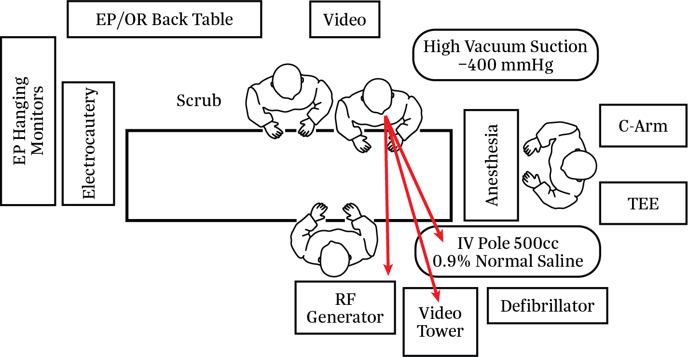
Hybrid AF Convergent Therapy Procedure: Room Setup
PE-US-0004C-0322-G

Slide 3
Patient Positioning and Prep
Patient placed in supine position; arms tucked without shoulder roll. If sleds must be used, avoid right side (to maximize workspace for surgeon).
General anesthesia
Standard grounding pad for Bovie® – usually placed on thigh or buttock
1 Amp grounding pad for RF Generator (CS-3000) – placed left flank (see image on next card)
Defibrillator pads placed and connected to external defibrillator
TEE to rule out LAA thrombus
Central line – usually done after TEE cleared
Arterial line
Foley catheter
Warming blanket
SCD (institution dependent)
Standard wall suction (-250mmHg) and tubing to cannula
High vacuum suction (-400mmHg) and tubing to EPi-Sense® Device
Temperature probe placed by anesthesia and verified under fluoroscopy (C-Arm needed if done in cardiac OR)
Prep – chin to mid thigh
RF Generator default settings are 30 W for 90 seconds – these settings should not be changed unless requested by the surgeon
PE-US-0004C-0322-G

Slide 4
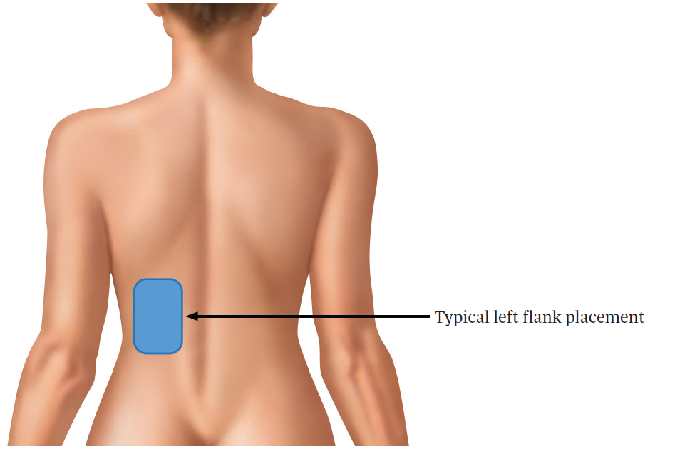
1 Amp Grounding Pad Placement
PE-US-0004C-0322-G

Slide 5
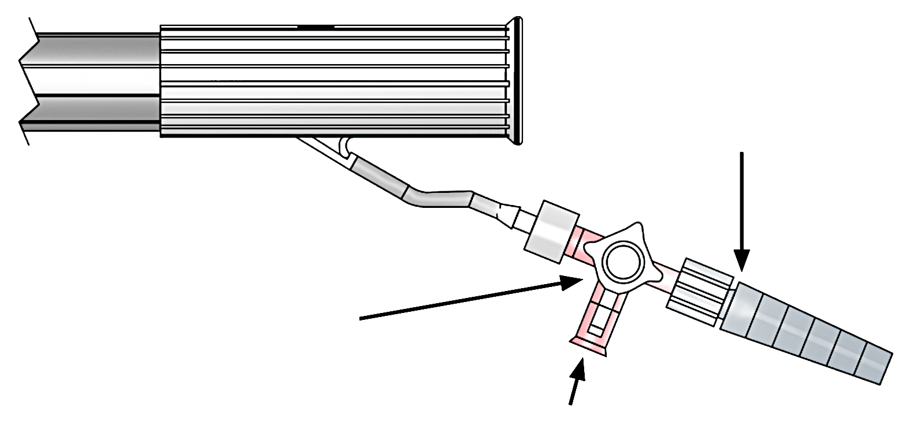
Cannula Set-Up
To Vacuum Tubing
Stopcock
To sterile IV Tubing connected to 1 LITER NS or STERILE WATER (room temp, pressurized); alternatively Asepto syringe may be used instead of IV tubing/pressurized liter bag of fluid for cannula irrigation
PE-US-0004C-0322-G

Slide 6
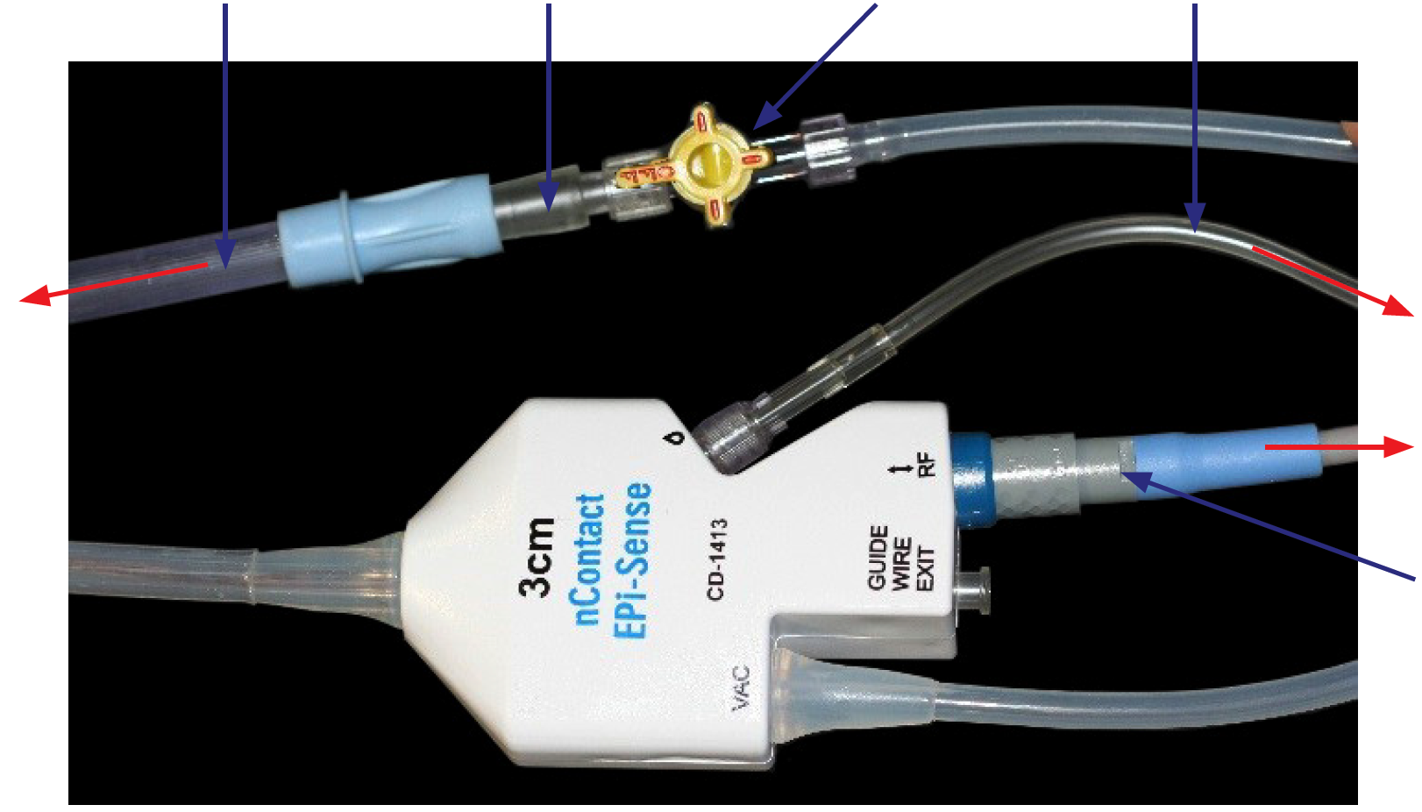
EPi-Sense Device Set-Up
Vacuum Tubing
Stepped Luer Fitting
Stopcock
IV Tubing
To -400 mmHG Vacuum
To Unpressurized Normal Saline Bag
To RF Generator
RF Cable
PE-US-0004C-0322-G

Slide 7
Hybrid AF Convergent Therapy Procedure: Device Set-Up
Prepare the Vacuum
Attach one end of the sterile vacuum tubing to the graduated fitting where indicated on device handle by the vacuum symbol (‘VAC’) and the other to the vacuum trap. Use the stopcock to apply and release the vacuum to the distal assembly.
Ensure the vacuum unit pressure is set to –400 mmHg
Prepare the 0.9% Normal Saline Bag
Place unpressurized saline IV bag at patient height or above.
Connect perfusion tubing to female Luer connection where indicated on device handle by the perfusion “droplet” symbol. Verify IV line is fully open.
PE-US-0004C-0322-G

Slide 8
Hybrid AF Convergent Therapy Procedure: Device Set-Up continued
Insert IV tubing set into 0.9% normal saline bag.
Turn on vacuum pressure and prime device by engaging the suction with a sterile surface (gloved hand).
Ensure perfusion flow is functioning by observing drops in IV tubing drip chamber. Make sure the device is primed by observing perfusion at distal end of coagulation device before starting operation of device. Ensure IV line is fully open.
Insert device into cannula and advance to target tissue
Confirm arrows point toward target tissue and apply vacuum
Irrigate field (1L NS pressurized connected to cannula or with sterile irrigated bulb syringe)
PE-US-0004C-0322-G

Slide 9
Hybrid AF Convergent Therapy Procedure: Procedural Steps
Surgeon makes small (2-3 cm) incision over xiphoid process – surgeon may elect to remove some/all of xiphoid process
Surgeon establishes sub-xiphoid (Sub-X) pericardial window
AtriCure cannula placed behind heart within pericardial window
Introduce 0º 5 mm scope through cannula
Through scope, identify landmarks on posterior left atrium
Ready to ablate
PE-US-0004C-0322-G

Slide 10
Hybrid AF Convergent Therapy Procedure: Optional LAA Management
12 mm trocar, quantity of one
5 mm trocar, quantity of two or three (physician preference)
5 mm 30° scope
Insufflation tubing
Harmonic® scalpel, Ligasure™ device, Endoseal™ or L-hook cautery
Inflatable patient positioning device, placed under left scapula
Assess for optimal placement by inflating and deflating prior to prepping
Laproscopic graspers
Endoscopic Kittner
Endoscopic retention stitch (hold) and suction/irrigator (hold)
PE-US-0004C-0322-G

Slide 11
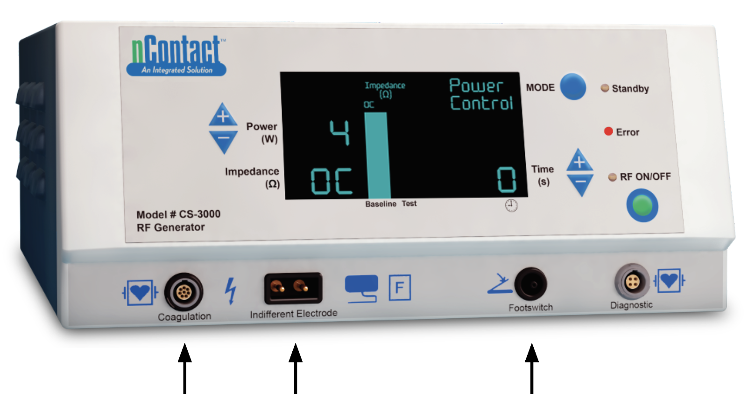
CS-3000 RF Generator – Front Connections
When no device is connected to the blue end of the RF cable, a power of 4 W and time of 0 seconds will display on RF Generator. The Error LED will remain lit until a connected device is in contact with tissue.
RF Cable
1 Amp
Grounding Pad Connection
Footswitch
PE-US-0004C-0322-G

Slide 12
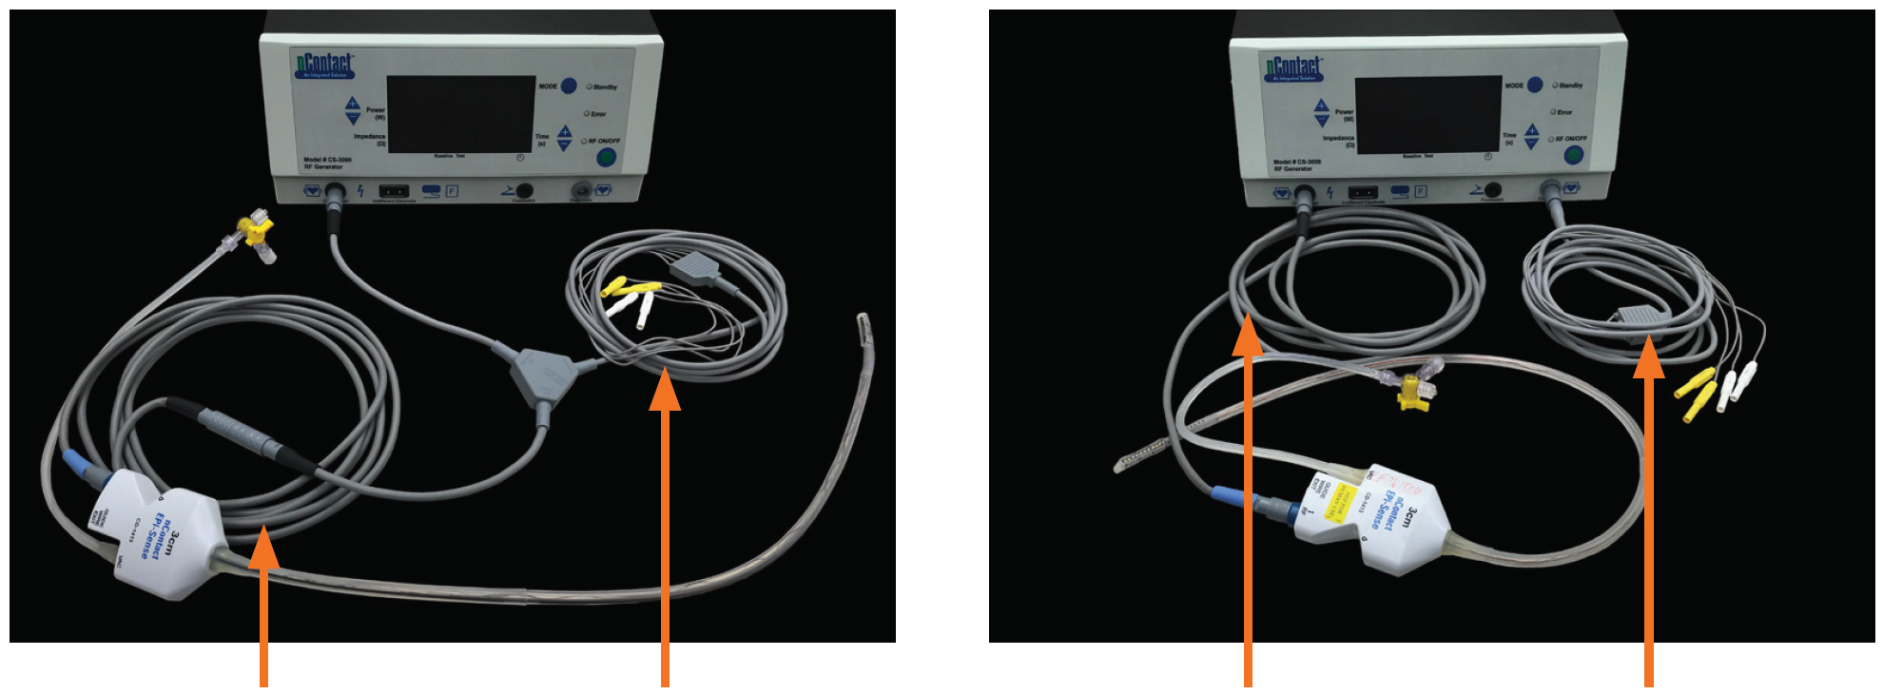
CS-3000 RF Generator Unit-Front Connections continued Cables Used with EPi-Sense Device
CSK-2030 Connections
CSK-2010 Connections
CSK-2000
CSK-2030
CSK-2000
CSK-2010
PE-US-0004C-0322-G

Slide 13
Reference: PM-US-0045A-1020-G Closed Chest Access Using Cannula and EPi-Sense Coagulation Device
EPi-Sense® Guided Coagulation System
U.S. Indications: The EPi-Sense Guided Coagulation System is intended for the treatment of symptomatic long-standing persistent atrial fibrillation (continuous atrial fibrillation greater than 12 months duration) when augmented in a hybrid procedure with an endocardial catheter listed in the instructions for use, in patients (1) who are refractory or intolerant to at least one Class I and/or III antiarrhythmic drug (AAD); and (2) in whom the expected benefit from rhythm control outweighs the potential known risks associated with a hybrid procedure such as delayed post-procedure inflammatory pericardial effusions. Contraindications include patients with Barrett’s Esophagitis, left atrial thrombus, a systemic infection, active endocarditis, or a localized infection at the surgical site at the time of surgery. Adverse Events: Reported adverse events associated with epicardial ablation procedure may include, but are not limited to, the following: pericardial effusion/cardiac tamponade, pericarditis, excessive bleeding, phrenic nerve injury, stroke/TIA/neurologic complication. Please review the Instructions for Use for a complete listing of contraindications, warnings, precautions and potential adverse events located at the following AtriCure web address: https://www.AtriCure.com/EPi-Sense-Coagulation-Device. Warnings: Physicians should consider post-operative anti-inflammatory medication to decrease the potential for post-operative pericarditis. and/or delayed post-procedure inflammatory pericardial effusions. Physicians should consider post-procedural imaging (i.e. 1-3 weeks post-procedure) for detection of post-procedure inflammatory pericardial effusions. Precautions: Precautionary measures should be taken prior to considering treatment of patients: (1) Deemed to be high risk and who may not tolerate a potential delayed post-procedure inflammatory pericardial effusion. (2) Who may not be compliant with needed follow-ups to identify potential safety risks. To ensure patients undergoing treatment with the EPi-Sense device are well informed, the benefits, potential risks and procedural outcomes associated with the EPi-Sense Hybrid Convergent procedure should be discussed with the patient. Physicians should document accordingly in the medical record. Qualified operators are physicians authorized by their institution to perform surgical sub-xyphoid pericardial access. The coagulation devices should be used by physicians trained in the techniques of minimally invasive endoscopic surgical procedures and in the specific approach to be used. Operators should undergo training on the use of EPi-Sense device before performing the procedure. Safety and effectiveness of concomitant left atrial appendage closure was not evaluated in the CONVERGE study. Follow-up should be conducted at approximately 30 days post-procedure to monitor for signs of delayed onset pericarditis or pericardial effusion. Rx Only.
ATRICURE, INC. 7555 Innovation Way Mason, OH 45040 USA Customer Service: +1 (866) 349-2342 CustomerService@AtriCure.com www.AtriCure.com
PE-US-0004C-0322-G

